Slide 1
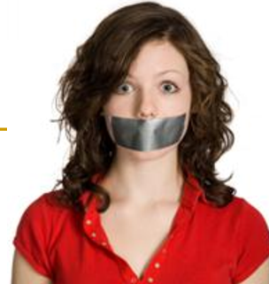
Barriers to Effective Communication

Slide 2
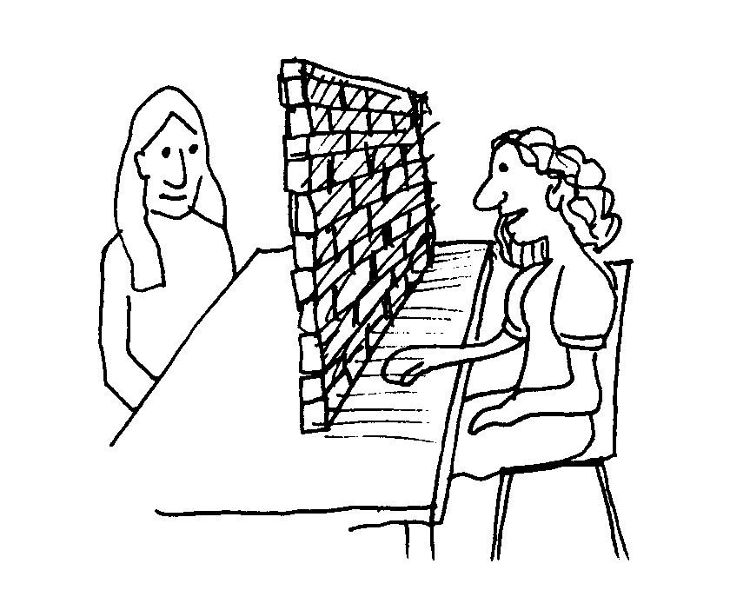
Definition
Any interference or noise that disrupts the smooth flow of effective communication.
These barriers may emanate from either the sender/receiver or the circumstances of communication.
They may confuse the listener or reader, create misunderstanding and confusion, and may sometimes lead to communication breakdown.

Slide 3
Barriers to Effective Communication
A careful analysis of communication barriers reveal that they are generally created by
improper encoding
bypassing
frame of reference
physical distractions
psychological and emotional interference
intercultural difference

Slide 4
Improper Encoding
Selection of inappropriate or unfamiliar linguistic code -------- communication breakdown due to misunderstanding or confusion

Slide 5
Bypassing
Misunderstanding resulting from missed meanings because of the use of abstract words and phrases on which both senders and receivers do not agree.
Words mean different things to different people.
Age, education and cultural background influence the language a person uses.

Slide 6
Frame of Reference
Your weakness in viewing others within your frame of reference may also lead to confusion and misunderstanding.
Interpretation of others’ point of view from your angle.
Preconceived notions and prejudices.

Slide 7
Physical Distractions
Physical discomfort may cause communication failure.
Noise
High room temperature
Fatigue
Sickness
Distance from the speaker or listener

Slide 8
Psychological and Emotional Interference
Any psychological or emotional turbulence or disturbance can prove to be a barrier to effective communication.
Sadness
Fear
Anger
Anxiety
Excitement

Slide 9
Attitudinal Barriers
Attitudinal barriers are behaviors or perceptions that prevent people from communicating properly.
Attitudes are commonly formed by an individual's opinions or personal feelings on a subject or person and can be difficult to alter.
When attitudinal barriers override the sense of professionalism in a workplace, it can become difficult for a group to engage in productive communication.

Slide 10
…………………..…….Continued
Abstracting-- It can also be referred to as "selective hearing."
Emotional Editing—It is an attitudinal barrier based on your personal feelings about a person or topic.
Prejudice-- Prejudice is the act of excluding of disliking someone or something because they belong to a particular group.

Slide 11
Assertiveness VS Aggressiveness
Assertiveness:
The term assertiveness is described as being self-assured and confident.
Assertive behavior includes politeness, firmness and confidence, but there is definitely no sign of aggression.
An assertive person pushes forth his take or opinion on a particular situation by keeping his voice calm and conversational.
Assertive persons are also keen listeners to other people's point of view. They value the freedom of personal tastes and choices.

Slide 12
Aggressive Behavior
An aggressive person is often known to blurt out his views and opinions without considering what others feel about the whole situation.
Such people are also known to impose their views forcibly on others

Slide 13
Intercultural Differences
Misinterpretation of meaning during intercultural communication due to different cultures and shared values.

Slide 14
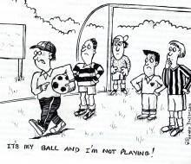
Attitudinal Barriers

Slide 15
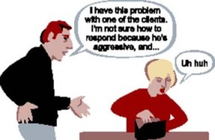
…….continued

Slide 16
Overcoming Barriers
Know your audience---- Try to know their needs, perceptions, and expectations from you.
Try to experience the world from the receiver’s perspective.
Use an appropriate and effective personal style and avoid using a negative or angry tone.
Encode your message well.

Slide 17
……..Continued
Avoid physical and psychological barriers.
Listen attentively.
Avoid information overload.
Be open, frank and positive.
Appreciate and understand cultural differences.

Slide 18
Thank You

